Slide 1

Program Overview
Tony Dickherber, Ph.D.
Program Director
Center for Strategic Scientific Initiatives (CSSI)
Office of the Director, National Cancer Institute (NCI)
National Institutes of Health (NIH)
April 2014

Slide 2
















National Institutes of Health (NIH): 27 Institutes and Centers
NHGRI
NIA
NIDA
NINDS
NIDCD
NIMH
NEI
NIAAA
CIT
NINR
NLM
NIDDK
NIH Campus – Bethesda, Maryland
FIC
CSR
NIBIB
NIMHD
NIDCR
NIEHS
NIGMS
NICHD
CC
NIAMS
NCATS
NCCAM
NIAID
NCI
NHLBI
NIH Budget ~ $30.14 Billion (FY14)
~81% for extramural support
~60,000 grants and contracts
NCI Budget ~ $4.92 Billion (FY14)
~ 75% for extramural support
~7,500 grants and contracts
http://officeofbudget.od.nih.gov/spending_hist.html

Slide 3

National Cancer Institute Organization
National Cancer Institute
$4.79B
(FY13)
Acting Director
Douglas Lowy, MD
Office of the Director
CSSI
~$110 M (~3%)
Center for Cancer Research
Division of Cancer Epidemiology and Genetics
Division of Cancer Treatment and Diagnosis
Division of Cancer Biology
Division of Cancer Control and Population Sciences
Division of Cancer Prevention
Division of Extramural Activities
~$812M (~17%)
~$1,166M (~32%)
~$726M (~20%)
~$398M (~11%)
~$249M (~7%)
~$22M (~0.5%)
Conducting – Intramural
Funding – Extramural
Red numbers: FY13 grants data only from http://fundedresearch.cancer.gov/nciportfolio; Black numbers: from FY13 http://obf.cancer.gov/financial/factbook.htm

Slide 4










NCI Center for Strategic Scientific Initiatives (CSSI): Concept Shop
Director
Douglas Lowy, MD
Deputy Director
Jerry S.H. Lee, PhD
Mission
“…to create and uniquely implement exploratory programs focused on the development and integration of advanced technologies, trans-disciplinary approaches, infrastructures, and standards, to accelerate the creation and broad deployment of data, knowledge, and tools to empower the entire cancer research continuum in better understanding and leveraging knowledge of the cancer biology space for patient benefit…”
2003, 2007, 2011, 2013
2005, 2010
2008
2011
2004, 2008
2005, 2008
2010

Slide 5
Unique Attributes of IMAT
Solicitation:
Emphasis on innovative technology with transformative potential (i.e. high-risk, high-impact)
Focus exclusively on technology development (NOT hypothesis-driven research)
100% investigator-initiated research grants
Review:
Special emphasis panels recruited based on focus of submissions, drawing heavily from former IMAT grantees
Milestone-based applications to quantitatively assess the capabilities of the technology (e.g., specificity, sensitivity, and speed) and characterize the improvement over state-of-the-art

Slide 6
Innovative Molecular Analysis Technologies (IMAT) Program
Program Mission:
To support the development, maturation, and dissemination of novel and potentially transformative next-generation technologies through an approach of balanced but targeted innovation in support of clinical, laboratory, or epidemiological research on cancer.
Proof of Principle
Advanced Development
Testing & Validation
Scale Up
Technology Development Pipeline
Concept
Dissemination
R21
≤$400k over 3 years
direct cost support
Feasibility/Proof-of-principle study
Highly innovative technology
No preliminary data required
R33
Advanced development & validation phase
Demonstration of transformative utility
Requires proof of feasibility
≤$900k over 3 years
direct cost support
R43
R44
≤ $225k over 6m total cost support
≤ $1.5M over 2 years
total cost support
Development & (regulatory) validation
Manufacturing & marketing plan
Requires proof of feasibility and commercialization plan
Demonstration of transformative utility
Feasibility study
Clear commercial potential
Fast-Track

Slide 7
IMAT credits to date…
Proteomics
Dynamic Range Enhancement Applied to Mass Spec (DREAMS)
Gateway ORF Cloning Tool
Multi-Dimensional Protein Identification Technology (MuDPIT)
Isotope-Coded Affinity Tags (ICAT)
Synchrotron Protein Footprinting
Nanowire field effect transistors (NWFETs)
Deuterium exchange Mass Spec (DXMS)
Nucleic Acid Programmable Protein Array (NAPPA)
Genomics
Digital Optical Chemistry
Rolling Circle Amplification
Representational Oligonucleotide Microarray Analysis(ROMA)
Multi-photon Intravital Imaging (MPIVI)
Recombomice
Pyrophosphorolysis Activated Polymerization (PAP)
Pair-end Sequencing to screen structural rearrangements
Digital Transcriptome Subraction
Zinc Finger Nucleases for targeted double-strand breaks
COLD-PCR
Epigenomics
Differential Methylation Hybridization (DMH)
Chromatin Immunoprecipitation with next gen Sequencing (ChIP-Seq)
Clinical Diagnostics
Paramagnetic chemical exchange saturation transfer (ParaCEST)
Near IR Probes for in vivo diagnostics
MicroSOL IEF (Invitrogen as Zoom IEF Fractionator)
Microfluidic Genetic Analysis (MGA) chip
Oncomap (a.k.a., OncoPanel)
Mass Spec ImmunoAssays (MSIA) from Intrinsic Bioprobes
PhosphScan® kits from Cell Signaling Technology, Inc
Sample preparation
Magnetic Cell Sorting, now available from Ikotech
RainDance Oil Droplet Microfluidics
Cryopreservation followed by culturing of CML cells
NanoVelcro
Drug Screening or Delivery
One Bead One Compound (OBOC)
Genetically modified T-cells for treatment, targeting acute lymphoblastic leukemia
PI 3K inhibitor screening platform from Echelon Biosciences (now Aeterna Zentaris)
ONIX microfluidic perfusion cell toxicity screening system by CELLASIC Corp

Slide 8
Diversity of IMAT
Innovative Technologies for Molecular Analysis of Cancer (R21)
Proof-of-concept
Milestone driven (no biology)
Application of Emerging Technologies
for Cancer Research (R33)
Validation
Demonstration of impact on basic and/or clinical research

Slide 9
(Potential) Life Cycle of an IMAT Technology Development Project
Separate Application Process
Technology Dissemination via:
R21/Phase I
R33/Phase II
NCI Programs and Initiatives
Collaboration
Publication
Licensing
Commercialization
Mechanism:
Exploratory/pilot phase; requires innovative technology/approach; no preliminary data required
Mechanism:
Developmental/validation phase; requires significant feasibility data
Requirements:
Description of study
Relevance to cancer
Quantitative milestones
Truly novel tool/capability
Improvement over state-of-the-art
Requirements:
Plan for developing the technology to be useful to a category of cancer researchers or clinicians
Description of potential impact for the field
Description of completed milestones or evidence of technical feasibility
Technology Tools for Researchers:
Better – higher resolution, more detailed analysis, improved specificity/ selectivity/ sensitivity
Faster – faster processing, massively multiplexed
Cheaper – simpler or more robust design, field-ready

Slide 10
Active IMAT Funding Opportunities
[R21] Early‐Stage Innovative Molecular Analysis Technology Development for Cancer Research FOA#: RFA-CA-15-002 Budget: $400k/3yrs (direct cost cap)
[R33] Advanced Development and Validation of Emerging Molecular Analysis Technologies for Cancer Research FOA#: RFA-CA-15-003 Budget: $900k/3yrs (direct cost cap)
Molecular/Cellular Analysis Tools
[R21] Innovative Technologies for Cancer-Relevant Biospecimen Sciences FOA#: RFA-CA-15-004 Budget: $400k/3yrs (direct cost cap)
[R33] Advanced Development and Validation of Emerging Technologies for Cancer-Relevant Biospecimen Sciences FOA#: RFA-CA-15-005 Budget: $900k/3yrs (direct cost cap)
Sample QA/QC Tools

Slide 11
IMAT Awards for Small Business
Open to small business entities only
Molecular/Cellular Analysis Tools
Innovative Molecular Analysis Technology Development for Cancer Research and Clinical Care [FOA# PAR-13-327]
R43 Time: 6 months Budget: $150k (total cost cap)
R44 Time: 2 years Budget: $2M (total cost cap)
Sample QA/QC Tools

Slide 12
A Note on “Biospecimen Science”
Sample Quality Control (e.g., RNALater)
Focus on preserving the biological integrity of the molecular and cellular targets to be assessed
Spans the preanalytical time period from patient management variables, through sample procurement, immediate handling and preservation, and processing prior to analysis
Sample Quality Assessment (e.g., RIN)
Focus on verifying the biological integrity of the molecular and cellular targets to be assessed

Slide 13
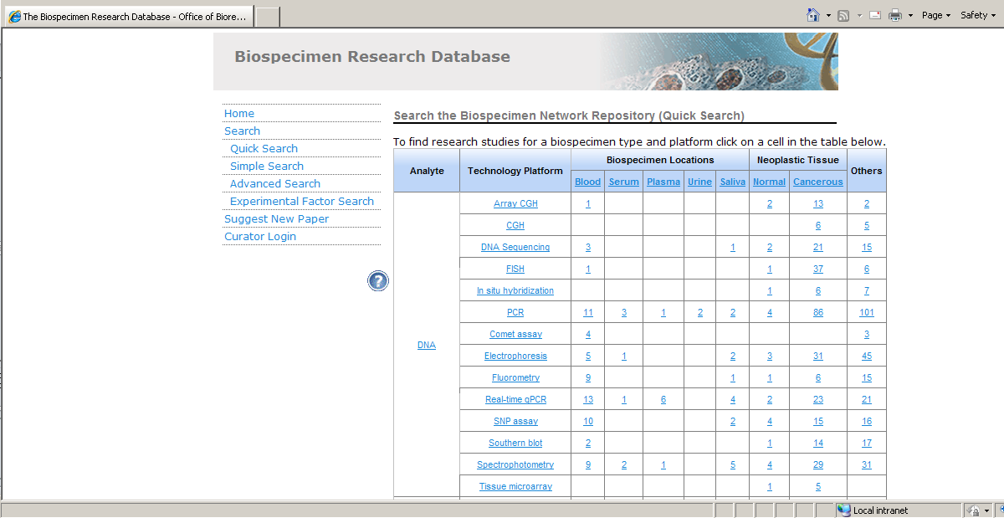
An Important Public Resource: Biospecimen Research Database
http://brd.nci.nih.gov

Slide 14
Non-responsiveness Criteria
Projects focused on a biological or clinical hypothesis for which the novelty resides in the biological or clinical question being pursued (i.e. traditional biological-hypothesis driven research);
Projects that propose to use existing technologies (for which proof of concept has already been obtained) that may be ready for the targeted applications without substantial further developmental efforts;
Projects that propose to develop only incremental technical advances to existing technologies projects that will have low potential for transforming cancer research;
Technologies for whole-body or in vivo imaging methods;
Projects involving clinical trials or toxicology studies;
Projects focused on biomarker discovery or biomarker validation;
Projects focused on development of specific contrast agents;
Projects focused on development of specific drugs or therapies;
Projects focused primarily on software/informatics solutions, database development, data mining, statistical tools, and computational/mathematical modeling (including those applicable to drug and/or patient responses) with the exception of projects which include software development for embedding in new devices or limited amounts of computational efforts as might be needed to develop new devices or methods;
Applications that may have appropriate scientific scope but do not include the required specific components (Statement of Impact and Quantitative Milestones) will also be considered non-responsive to this FOA and will not be reviewed.

Slide 15
R21 Milestones
Should be quantitative and scientifically justified
Critical components to include
Numerical performance targets (what)
Means by which they will be assessed (how)
Important review consideration:
Means of judging the success of the aims
Provide proof-of-principle for justifying further developmental effort
e.g., under a future R33 project

Slide 16
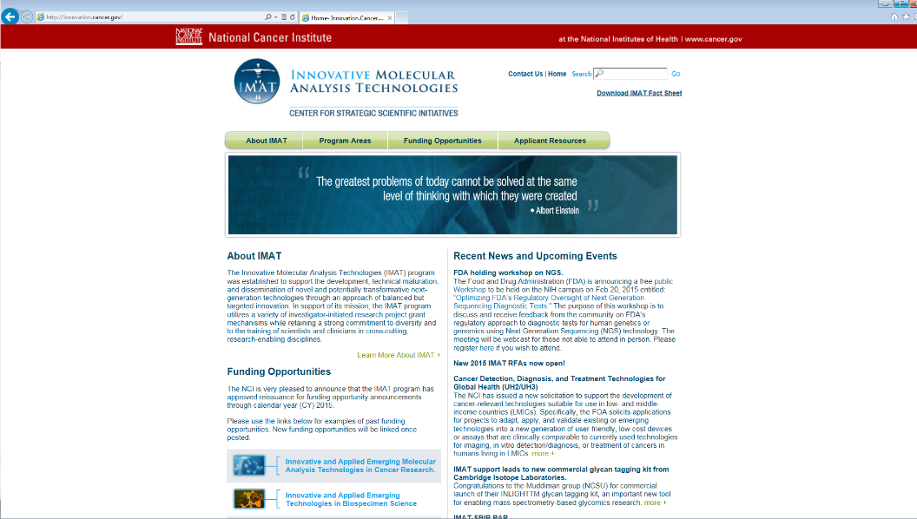
http://innovation.cancer.gov

Slide 17
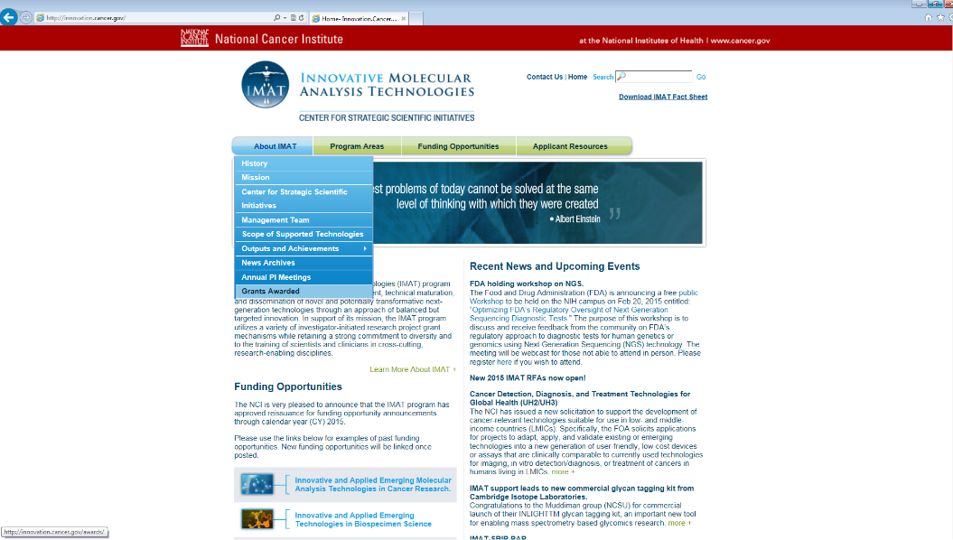
http://innovation.cancer.gov

Slide 18
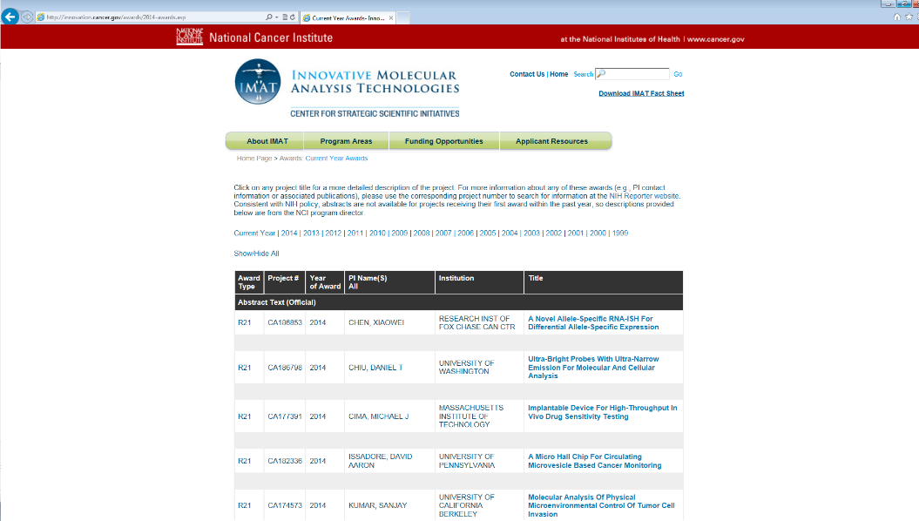
http://innovation.cancer.gov

Slide 19
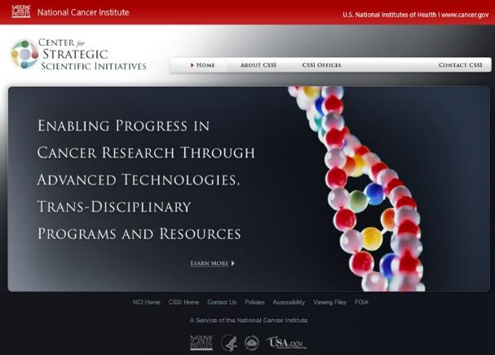
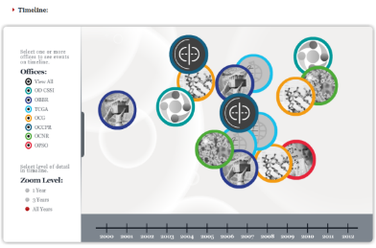
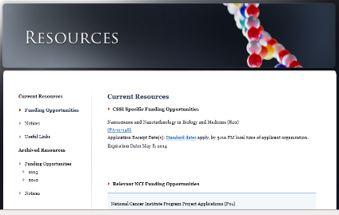
Learn More About Us…
http://cssi.cancer.gov
Tony Dickherber
anthony.dickherber@nih.gov
(301) 547 - 9980

